Slide 1
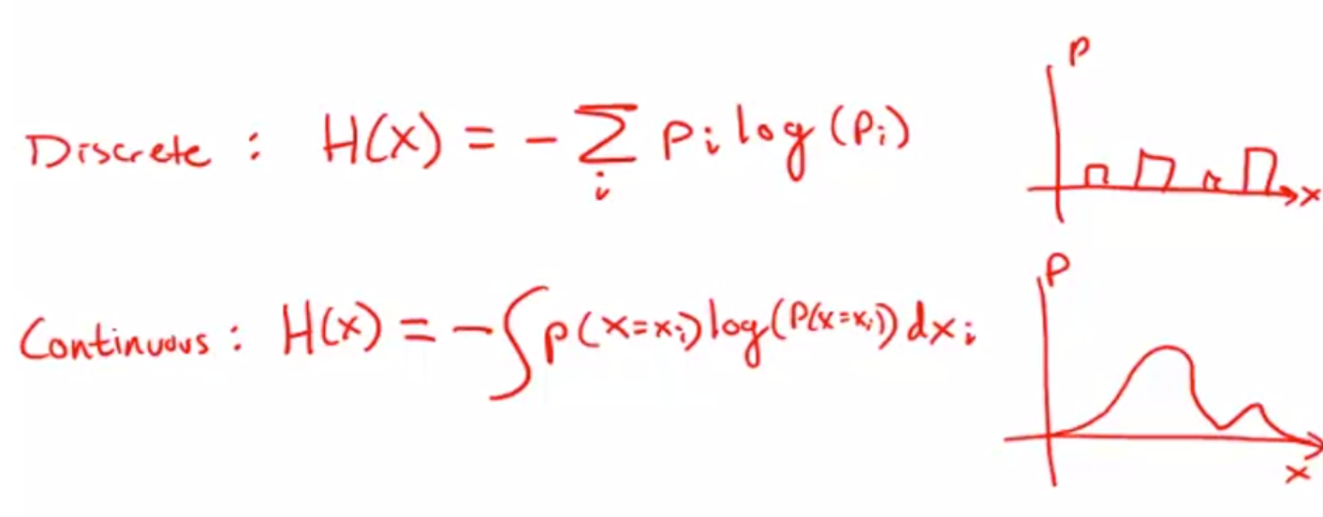
Notes:
Describe the uncertainty of the system

Slide 2
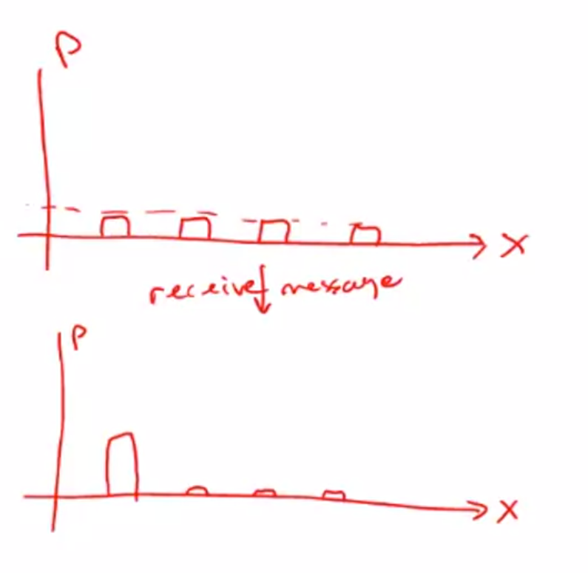

Slide 3
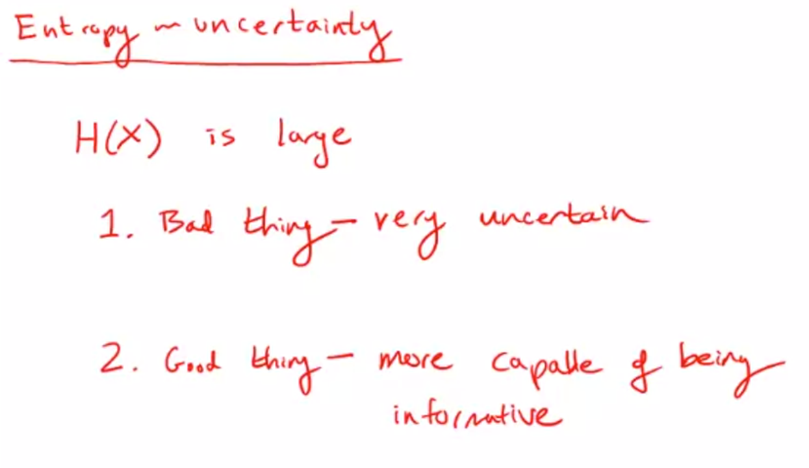

Slide 4
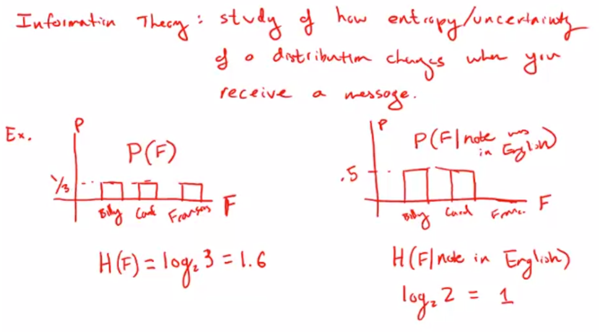

Slide 5
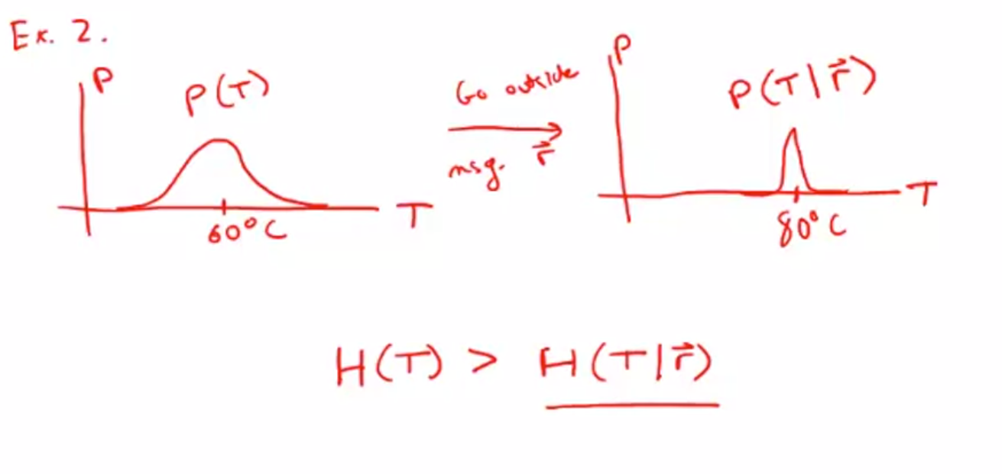

Slide 6
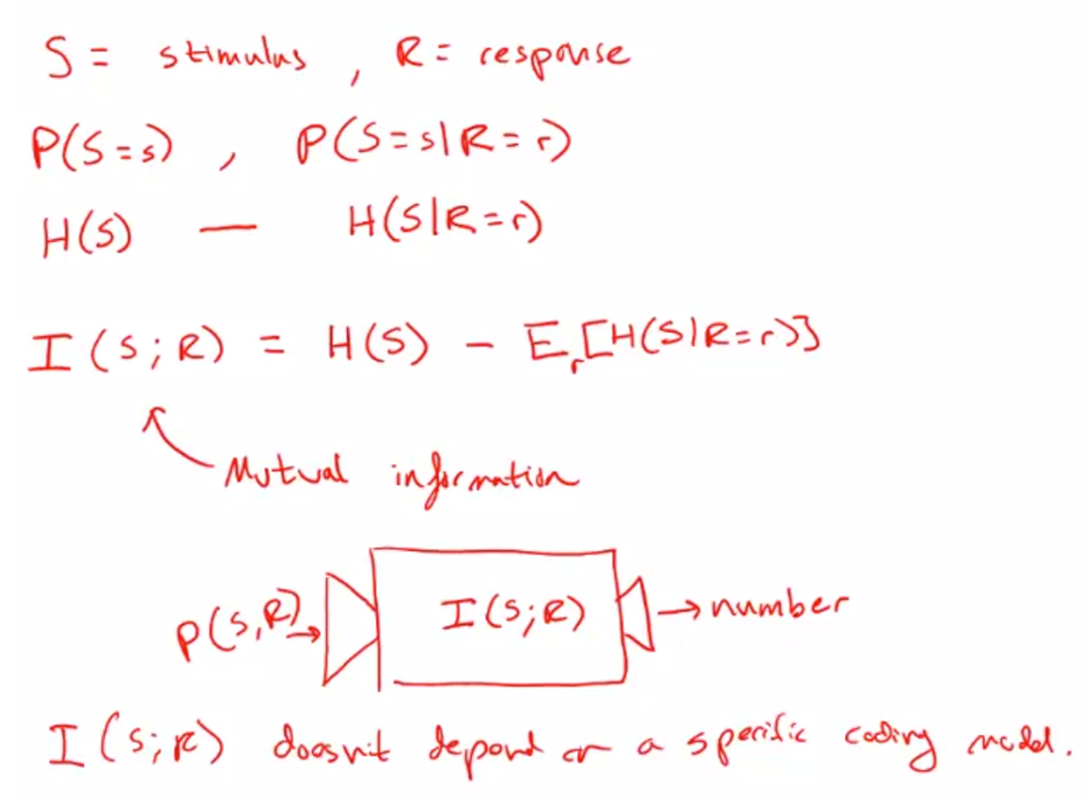

Slide 7
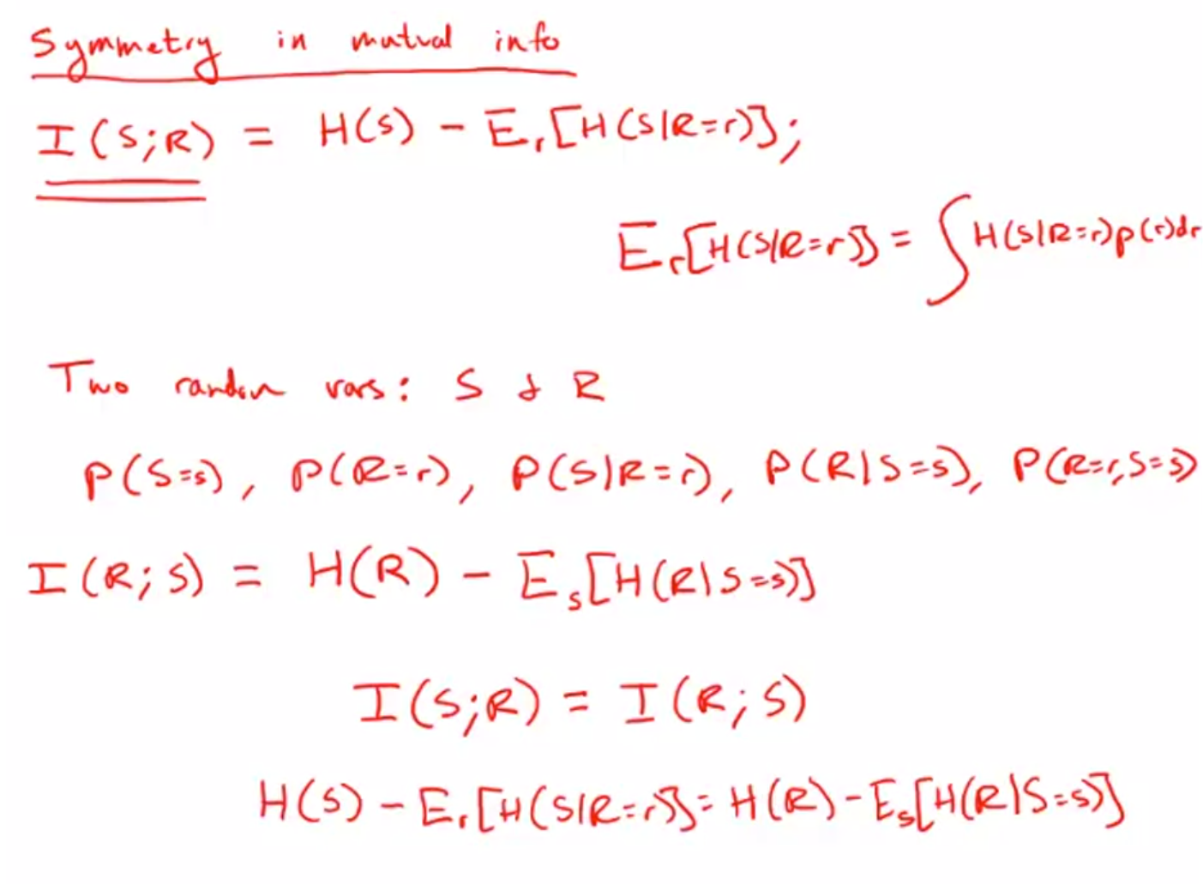
Notes:
This is a very useful calculation that tells us how much we can learn about one variable given the choice of the other variable.
It tells us how correlated two random variables are, how correlated the temperature outside is to a pattern of spikes in your sensory neurons.
How correlated the motion of a rat's whisker is to the signal that gets sent to its barrel cortex.
It gives us a model free way of talking about how much two probabilistic quantities convey about one another.

